Slide 1

Data Mining Text Mining
Data Mining
Dr. Sajarwo Anggai, S.ST., M.T. NIDN : 0421108703

Slide 2
Pertemuan 10 (Bag of Words)

Slide 3
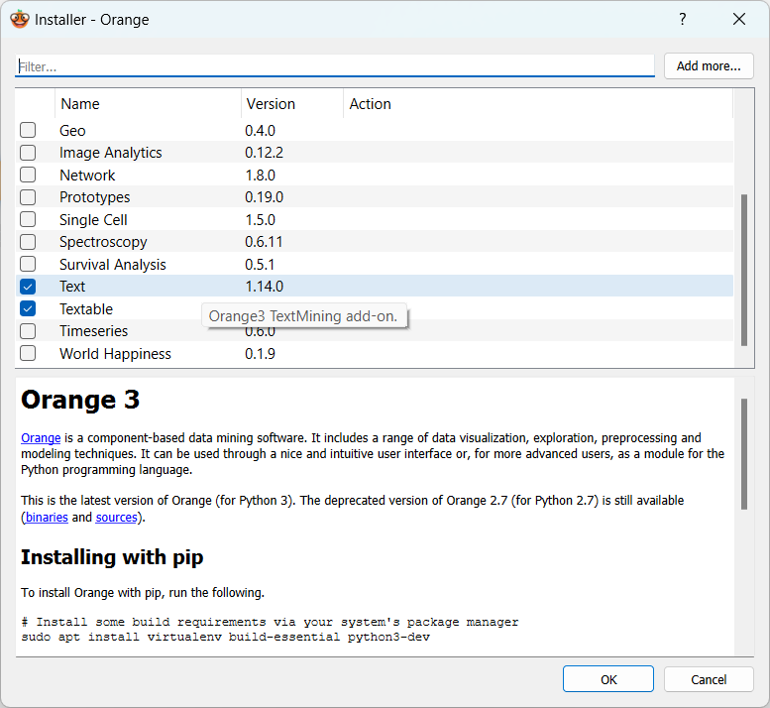
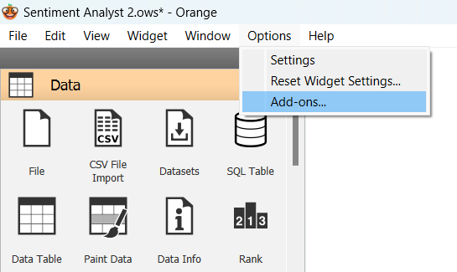
Install Plugin Text Mining

Slide 4
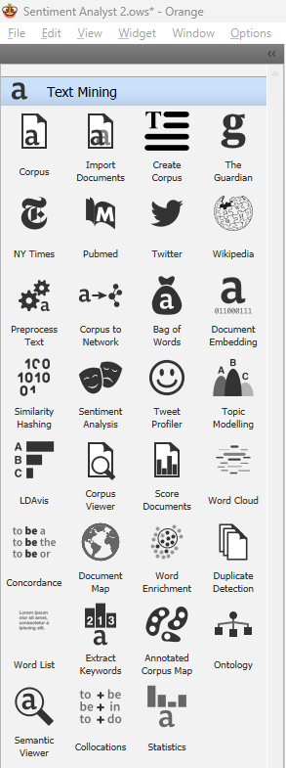
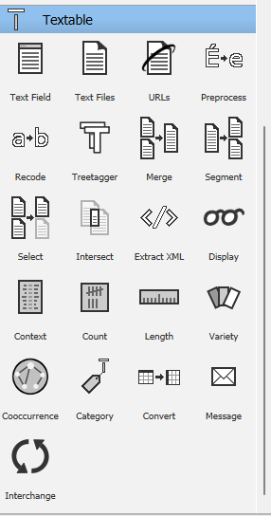
Widget Text Mining

Slide 5

Contoh Pemanfaatan Fitur

Slide 6
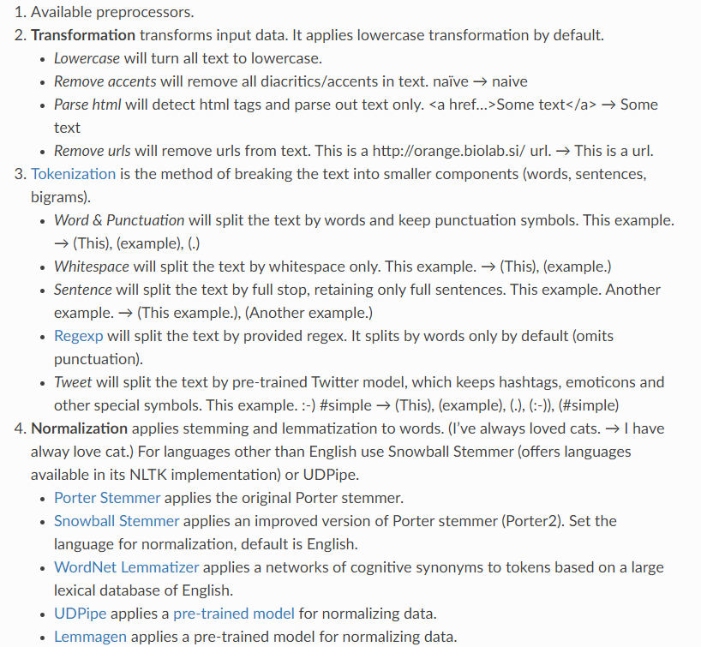
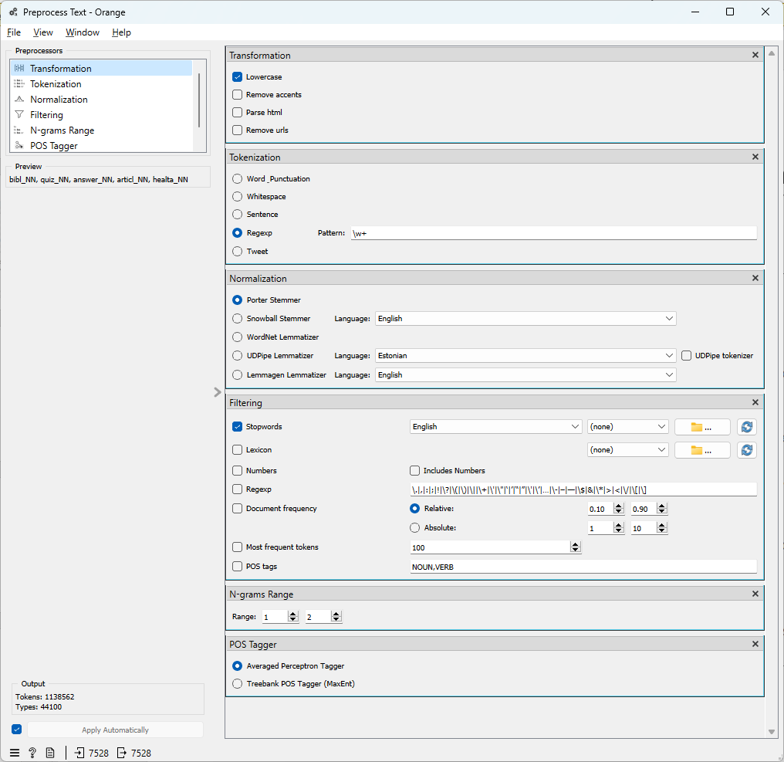
Preprocess Text
https://orange3-text.readthedocs.io/en/latest/widgets/preprocesstext.html

Slide 7
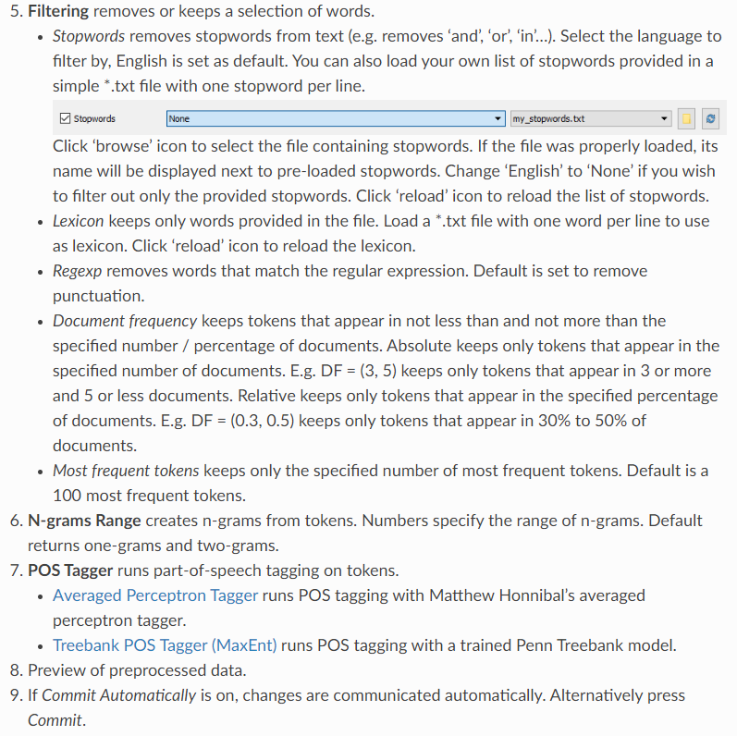
Preprocess Text
https://orange3-text.readthedocs.io/en/latest/widgets/preprocesstext.html

Slide 8
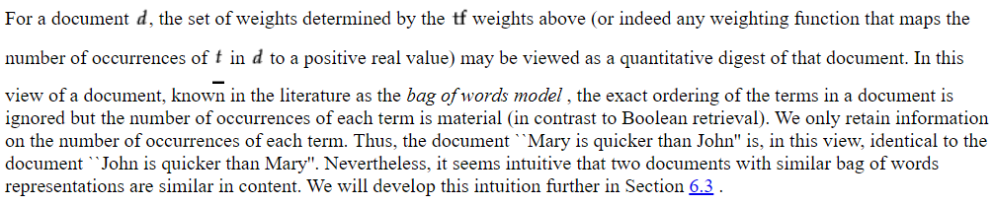
Bag of Words (Term Frequency)
https://nlp.stanford.edu/IR-book/html/htmledition/term-frequency-and-weighting-1.html

Slide 9
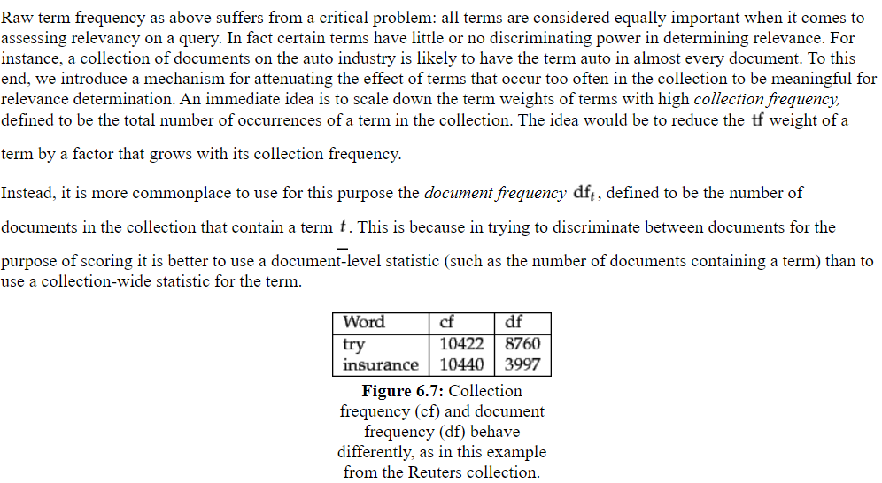
Bag of Words (Document Frequency & Inverse Document Frequency)
https://nlp.stanford.edu/IR-book/html/htmledition/inverse-document-frequency-1.html

Slide 10
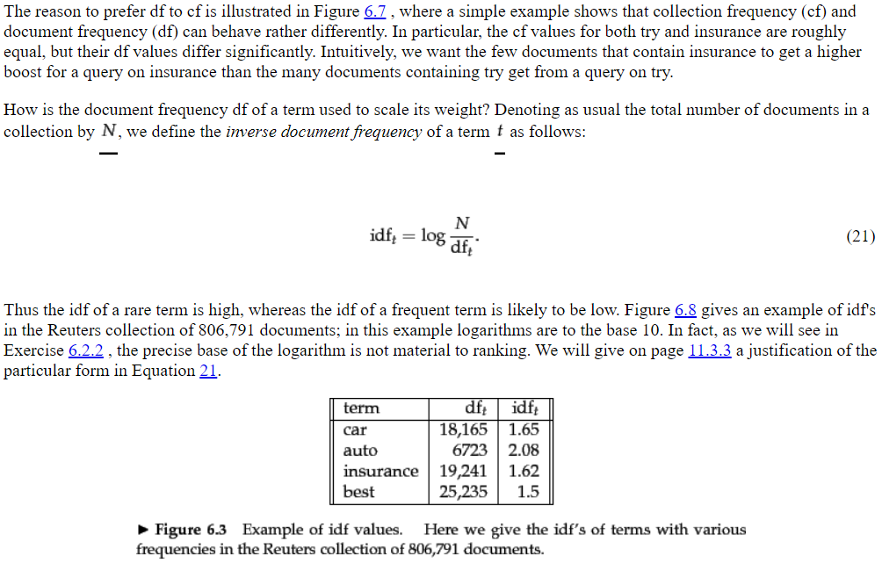
Bag of Words (Document Frequency & Inverse Document Frequency)
https://nlp.stanford.edu/IR-book/html/htmledition/inverse-document-frequency-1.html

Slide 11
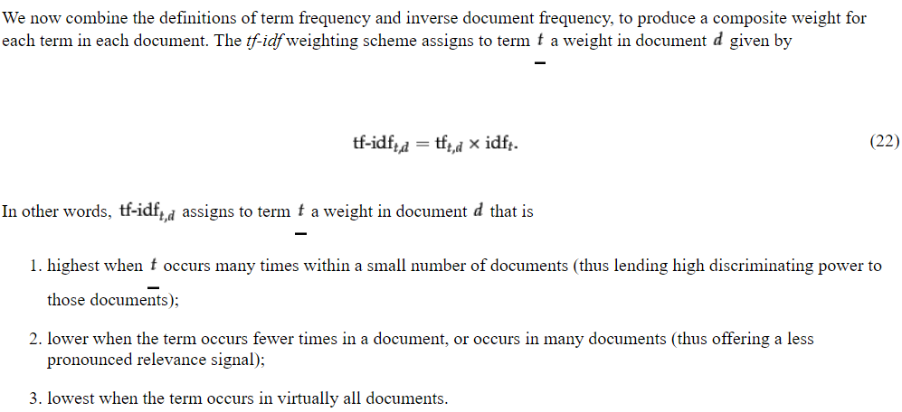
Bag of Words (TF-IDF)
https://nlp.stanford.edu/IR-book/html/htmledition/tf-idf-weighting-1.html

Slide 12
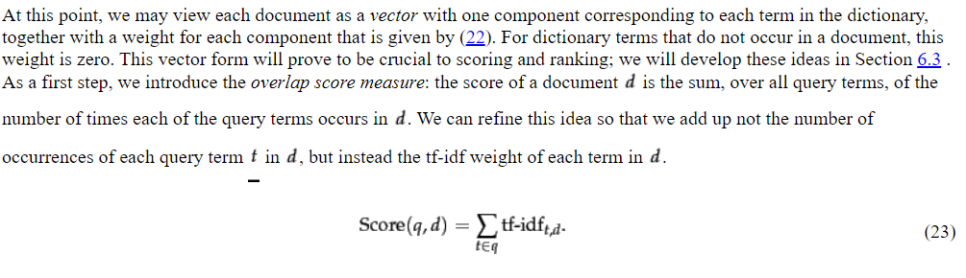
Bag of Words (TF-IDF)
https://nlp.stanford.edu/IR-book/html/htmledition/tf-idf-weighting-1.html

Slide 13
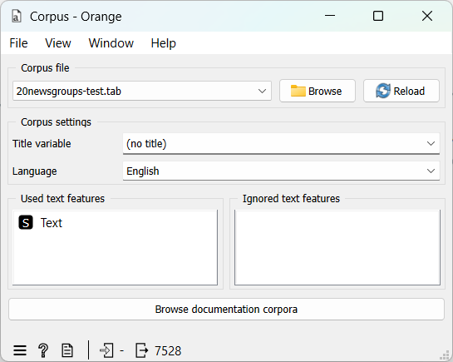
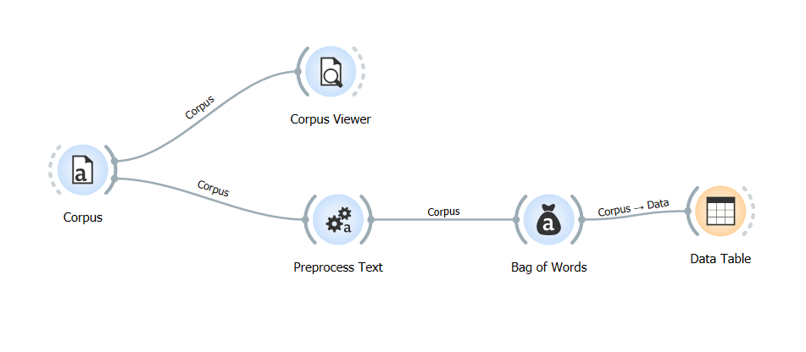
Preprocessing Text & Bag of Words

Slide 14
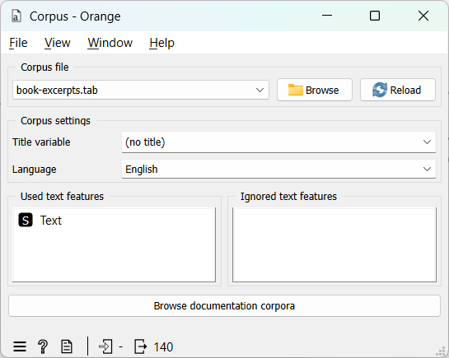
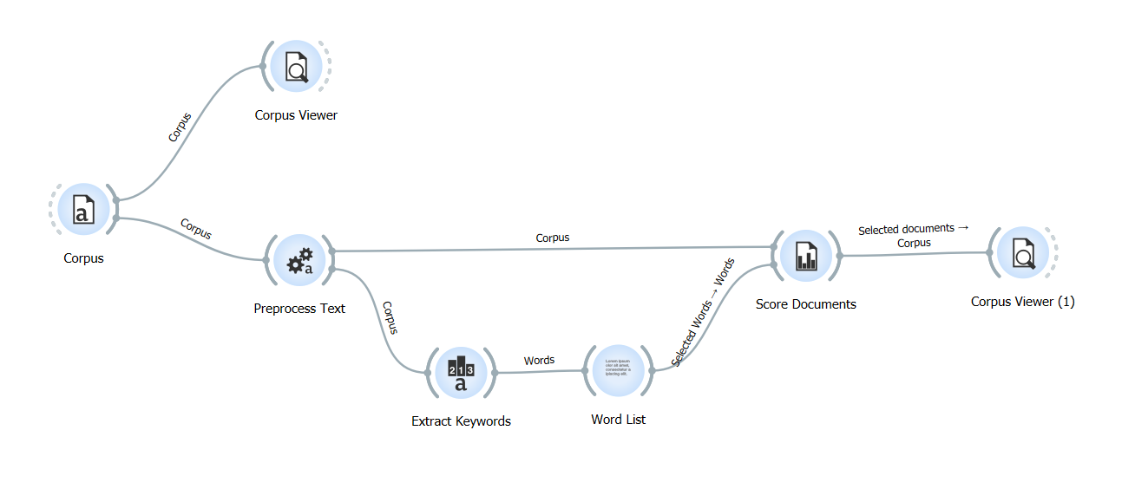
Similarity
https://orange3-text.readthedocs.io/en/latest/widgets/score-documents.html

Slide 15
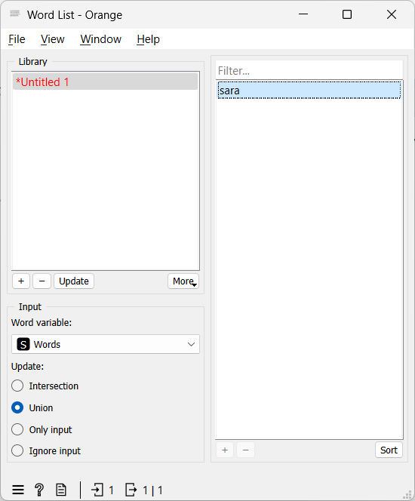
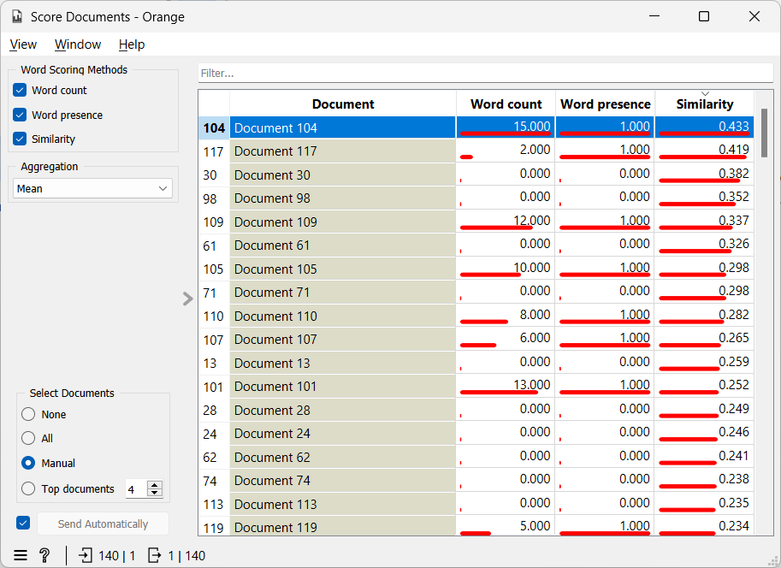
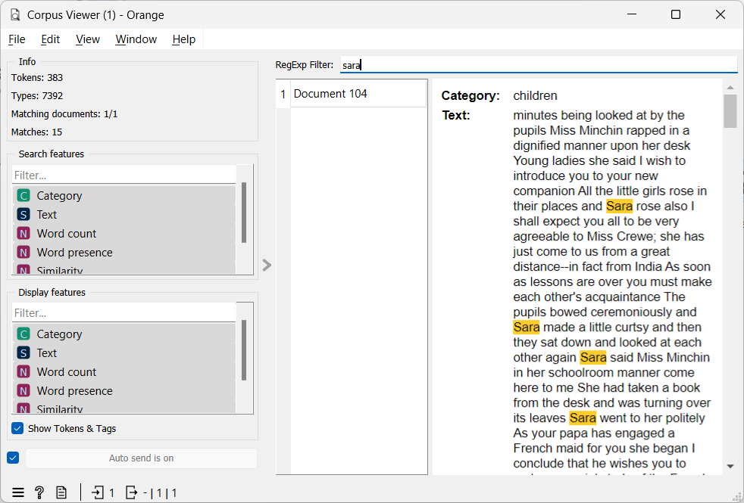
Similarity
https://orange3-text.readthedocs.io/en/latest/widgets/score-documents.html

Slide 16





Ref Tambahan
https://www.youtube.com/watch?v=konCCHcOL74&list=PLYW0LRZ3ePo5jW_mhbvHV5ciNkhe61dTT&index=46
https://www.youtube.com/watch?v=zxqip6o1MUc&list=PLYW0LRZ3ePo5jW_mhbvHV5ciNkhe61dTT&index=48
https://www.youtube.com/watch?v=4BmeEo0OWbs&list=PLYW0LRZ3ePo5jW_mhbvHV5ciNkhe61dTT&index=59
https://www.youtube.com/watch?v=cmGqq8o3nfU&list=PLYW0LRZ3ePo5jW_mhbvHV5ciNkhe61dTT&index=47
https://www.youtube.com/watch?v=7q2hYjH9NDY&list=PLYW0LRZ3ePo5jW_mhbvHV5ciNkhe61dTT&index=49

Slide 17
Tugas
Buatlah Perhitungan Manual untuk TF-IDF
Buatlah Preprocessing Text & Bag of Words
Buatlah Similarity dengan memanfaatkan Widget Score Documents
Tampilkan dalam bentuk Word Cloud
Cari 10 Jurnal terkait TF-IDF maupun Similarity (VSM)
Diskusikan di Forum Diskusi Pertemuan 10

Slide 18

Universitas Pamulang
Magister Teknik Informatika
Sajarwo Anggai
Dosen – Universitas Pamulang
NIDN : 0421108703
Email : dosen02832@unpam.ac.id
WA : 082343006557
Terima Kasih

